Slide 1
创建并调用React Component在页面上呈现内容。
Vocabulary: react, component, render,
Notes:
Teacher Notes:
Coders should read aloud the objective. Students should read through each vocabulary word.

Slide 2
React是一个用于构建用户界面的JavaScript库。 它使您可以从孤立的小代码段（称为“组件”）组成复杂的UI。
Notes:
Teacher Notes:

Slide 3
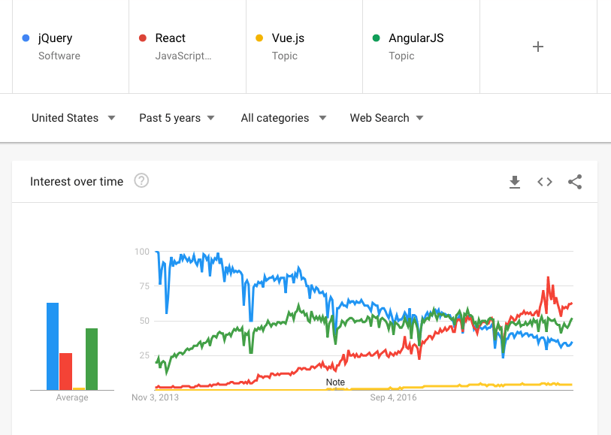
人们为什么使用React？
Notes:
Teacher Notes:
Show how react is getting more popular than jQuery now

Slide 4
我们为什么要学习它？
许多组织使用的流行前端框架
适用于制作大型应用
可以将代码分成组件
很多很棒的库
Notes:
Teacher Notes:
Use this time to show the benefits of using react and why students should be excited!

Slide 5
React 组件（Component）
组件是可重用的模板，可加快开发速度，并提供一种简便的方法来创建更复杂的Web应用程序。
Notes:
Teacher Notes:
Much of this unit is around creating components. It’s important student internalize what a component is.

Slide 6
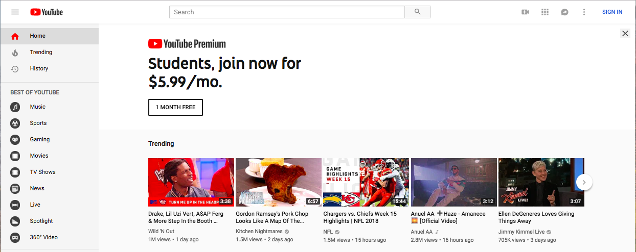
React Component
Notes:
This slide has animations! Show how you can break up a UI into components / reusable templates.

Slide 7
装node.js
https://nodejs.org/zh-cn/download/
node -v
npm -v

Slide 8
在终端里进入 061-Guided-Practice 目录
（Mac电脑：用鼠标选中目录，按 command+alt+c
拷贝这个目录的路径。然后到终端窗口里，cd command + v ）
npm install
会下载250M的文件
然后
npm start
一起练
“你好”
Notes:
https://repl.it/@PeterJablonski/061-Guided-Practice

Slide 9
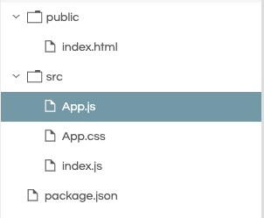
看这些文件
Public：公共的
Index：索引
Src：源文件
App：应用
Package：软件包
Notes:
Review the file structure of a React App

Slide 10
import React from 'react';
export default function App() {
}
App.js
组件叫“我的App”
Import 导入
From 从
Export 导出
Default 默认
Function 函数
App 应用
Notes:
Show the template of a React component.

Slide 11
在render（渲染）方法中添加一个return（返回）语句
告诉它在网页上显示什么
import React from 'react';
export default function App() {
return “你好";
}
Notes:
The App component returns the text “hi” and renders it on the screen

Slide 12
也可以返回HTML
注意：这是在JS中写HTML!
import React from 'react';
export default function App() {
return <h1> 你好 </h1>;
}
Notes:
React lets us write HTML syntax inside javascript! This returns an h1 tag and renders it on the screen.

Slide 13
import React from 'react';
export default function App() {
return (
<div>
<h1> 你好 </h1>;
</div>
);
}
你可以把整个HTML文件写在这！
如果超过一行，加上括号！
Notes:
We can render an entire HTML page here! If we are returning complex HTML on more than one line make sure there are parenthesis surround the HTML.

Slide 14
import React from 'react';
export default function App() {
return (
<h1> 你好 </h1>;
<p> 罗家祥 </p>
)
}
错误！
React组件只能包含一个顶级元素。通过将所有内容包装在一个div中来解决此问题。
Notes:
Animations! React component must only have one top level element. Fix this by wrapping everything in a single div.

Slide 15
import React from 'react';
export default function App() {
return (
<h1> 你好 </h1>;
<p> 光明 </p>
)
}
错误！
React组件只能包含一个顶级元素。通过将所有内容包装在一个div中来解决此问题。
<div>
</div>
Notes:
Animations! React component must only have one top level element. Fix this by wrapping everything in a single div.

Slide 16
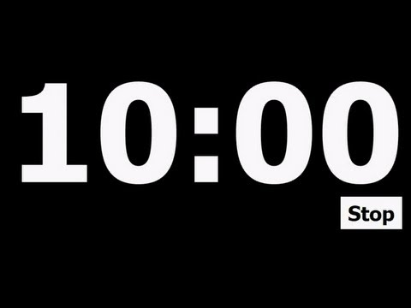
作业
1）安装node.js
2）解压作业文件
3）npm install
4）npm start
修改文件，完成渲染功能，使其包含
一个p标签
一个图像
一条链接
再添加3个您选择的标签！
Notes:
Teacher Notes:
Use this time to walk through the code together. Ask questions along the way. Have students type along with you.
https://popcode.org/?snapshot=67d8801c-064c-442c-a308-5d6f5551f5d2

Slide 17
你可以做出更多组件
比如一只猫

Slide 18
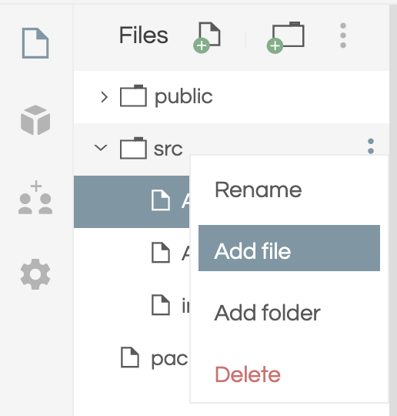
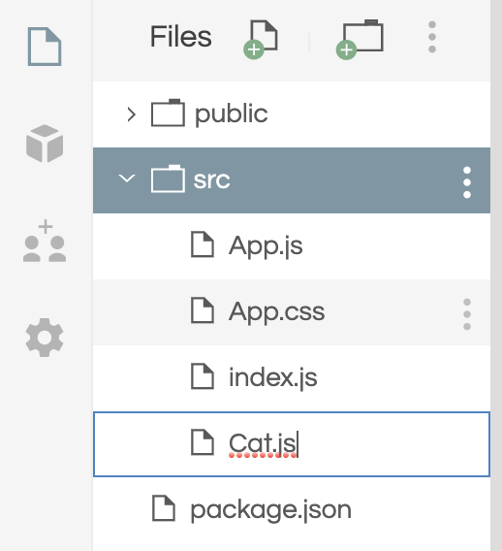
创造一个新文件 Cat.js
放到src目录下
Cat：猫

Slide 19
在Cat.js中，让我们制作一个“猫”的组件
import React from 'react';
export default function Cat() {
return <h1> 猫 </h1>;
}
Cat.js

Slide 20
Import：导入
import React from 'react';
import Cat from ‘./Cat.js';
export default function App() {
return (
<div>
<h1> 你好，家祥 </h1>;
<Cat />
</div>
)
}
然后，我们可以在“我的app”中，调用“猫”组件
在App.js中，从cats.js import（导入），然后用模块的名字“猫”调用
Notes:
Make sure to highlight that we import the component. Then we can call the component down below with <Cats />

Slide 21
import React from 'react';
import Cats from './Cats';
export default function App() {
return (
<div>
<h1> Hello World</h1>;
<Cat />
<Cat />
<Cat />
</div>
)
}
如果你调“猫”多次，会怎么样呢？
会出现很多“猫”
这就是组件的“重用”
Notes:
Components are reusable! Now we can make as many cat components as we want!!

Slide 22
作业：
创建新组件，加入
创建一个显示狗的新组件Dog
在App.js中导入Dog组件
在App.js中调用Dog组件
创建一个名为Cow.js的新组件
在App.js中导入Cow组件
在App.js中调用Cow组件
Notes:
Teacher Notes:
Use this time to walk through the code together. Ask questions along the way. Have students type along with you.
https://popcode.org/?snapshot=67d8801c-064c-442c-a308-5d6f5551f5d2

Slide 23
index.js负责装载App到root div里
App.js负责显示整个页面，包括 h1, Cats
而Cat.js 负责显示每个Cat
相当于函数套函数再套函数。套了三层函数。所以会感觉有点绕。
Notes:
Teacher Notes:
Use this time to walk through the code together. Ask questions along the way. Have students type along with you.
https://popcode.org/?snapshot=67d8801c-064c-442c-a308-5d6f5551f5d2

Slide 25
玩一个游戏 21个问题
Notes:
Teacher Notes:
Skip if you don’t have time

Slide 26
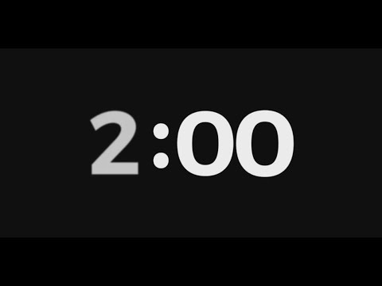
You're going to build a
Jeopardy
Notes:
Teacher Notes:
Get coders excited! Let students play with the game and discover the functionality. Click the link and have students interact with website. Have students turn and talk to discuss how to make the sample project.

Slide 27
在这个项目中，你注意到了什么？感兴趣的是？
怎么才能构建它？
您想怎么办？
需要学习什么？
Notes:
Teacher Notes:

Slide 28
项目计划文件！
与您的小伙伴：
在“详细信息”中描述用户访问您的网站时会发生什么
写下你想在游戏中问的问题和答案
Notes:
Teacher Notes: MAKE SURE TO HAVE PRINTED PLANNING DOCS
On this slide the lead instructor should open the project planning document link above and supporting instructors should pass out the printed project planning document sheets to students.
This should take only 10 minutes to complete. You should quickly walk through each section and explain what students should be completing. Giving 1-2 examples of each for the example project. Specifically numbers 3 and 4. Then give students the next 10 minutes to complete the sheet

Slide 29
Fork 起始代码
创建Jeopardy工作区，您需要
- Fork入门代码
- 单击Gitpod按钮
https://github.com/itscodenation/jeopardy
Jeopardy_starter
列
question-data
Notes:
Teacher Notes:
Students should start the project set up by forking the start code on GitHub

Slide 30
查看网页
进入目录
输入npm install
输入npm start
如果需要，您可以在ReadMe.md中找到此命令

Slide 31
阅读 README.md
每个项目都会有一个README文件，该文件会准确告诉您完成每个会话所需的内容。如果您无法在会话期间完成所有问题，则需要在下一次会话之前找到时间来完成它们。
Notes:
Teacher Notes:
Make sure to show student that the Readme file they have in their cloud 9 is the same as the one in their GitHub.

Slide 32
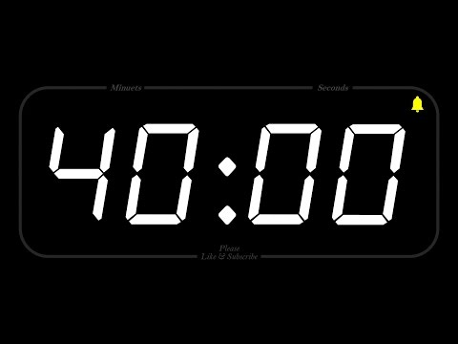
在这40分钟的工作时间结束之前，您的项目将需要...
一个名为Question的组件
在App.js中调用该组件，显示一些文本
使用CSS更新图像和样式
Jeopardy-hooks
Notes:
^{Teacher Notes:}
Leave these up so students can refer back to.

Slide 33
Do Now 06.2
诗歌
修改app.js，包括
Chorus
PreChorus
PostChorus模块
注意，要import
代码加入后，浏览器会立刻自动更新
非常方便
Notes:
https://repl.it/@PeterJablonski/062-Do-Now
Teacher Notes:
Use this time for students to come in and get ready.
Use this time to review the Do Now. Have a student come up and share what they’ve done.This should take no longer than 10 min. Do not spend too much time going into detail.

Slide 34
看看我们要干什么
Notes:
Teacher Notes:
https://popcode.org/?snapshot=716f58a6-d5f2-4e4b-9ec4-d40e30814aa2

Slide 35
使用 props 自定义React组件
Vocabulary: component, props,
Notes:
Teacher Notes:
Coders should read aloud the objective. Students should read through each vocabulary word.

Slide 36
React组件
组件是可重用的模板，可加快开发速度
可以用来很简便地创建复杂的Web应用程序
Notes:
Teacher Notes:
Components are Reusable. Write the code once and then use it a bunch of places!

Slide 37
Props
当前，我们的“问题”组件每次调用时都会显示相同的问题。
如果可以自定义组件上的特定值怎么办？
欢迎……Props 参数！
Notes:
Teacher Notes:
Components can use properties to customize the components!

Slide 38
React 组件
Notes:
Notice our previous example. We have a components that have the same structure but the content is different. What information changes from component to component?

Slide 39
62-Guided-Practice
猫
看看是怎么实现的

Slide 40
import React from 'react';
export default function cat() {
return (
<div>
<p> 名字：科蚪好友 </p>
<img src=”cat.jpg”/>
</div>
)
}
猫组件
Cat.js 文件
Notes:
^{This is review}

Slide 41
import React from 'react';
import Cat from './Cat.js';
export default function App() {
return (
<div>
<h1> Cats </h1>;
<Cat />
</div>
)
}
主App调用“猫”组件 <Cat />
Notes:
^{This is review}

Slide 42
import React from 'react';
import Cat from './Cat.js';
export default function App() {
return (
<div>
<h1> Cat Land! </h1>;
<Cat />
<Cat />
</div>
)
}
再来一只猫？
但它是一模一样的
:(
Notes:
Make sure to show that if you call the cat component multiple times it will show the same Cat image. But what if you want to change the name of the Cat??

Slide 43
<Cat name={“Tiny”}/>
import React from 'react';
import Cat from './Cat.js';
export default function App() {
return (
<div>
<h1> Cat Land! </h1>;
<Cat name={“科蚪之猫”}/>
</div>
)
}
用 Props 来解决这个问题!

Slide 44
<p> Name: {props.name} </p>
import React from 'react';
export default function Cat(props) {
return (
<div>
<p> Name: {props.name} </p>
<img src=”cat.jpg”/>
</div>
)
}
用花括号包括变量

Slide 45
为您的组件添加更多Props！
猫的颜色
爱好
主人
这样就能定制更多不同的Cat“猫”组件
Notes:
Teacher Notes:
Use this time to walk through the code together. Ask questions along the way. Have students type along with you.
https://popcode.org/?snapshot=67d8801c-064c-442c-a308-5d6f5551f5d2

Slide 46
<Cat
name={“Tiny”}
image={“image”}
/>
import React from 'react';
import Cat from './Cat.js';
export default function App() {
return (
<div>
<h1> Cats </h1>;
<Cat
name={“Tiny”}
image={“cat.png”}
/>
</div>
)
}
再加 1 个 prop

Slide 47
<img src={props.image}/>
import React from 'react';
export default function Cat(props) {
return (
<div>
<img src={props.image}/>
<p> Name: {props.name} </p>
</div>
)
}
它们都会被存在props里
这是什么语法？
对象！

Slide 48
向您的组件添加更多props！
furColor：毛色
size：大小
image ： 图片名词
type ：类型
调用更多props值不同的Cat组件！
Notes:
Teacher Notes:

Slide 49
10 minutes
Notes:
Teacher’s Note: This break is optional. Use your best judgment and remind students to take a break now or later.

Slide 51
What's New?
Here's the process for viewing your webpage in Gitpod
Navigate to your terminal
Type npm start
You'll be able to find this command in the ReadMe.md if you ever need it

Slide 52
在这40分钟的工作时间结束之前，您的项目将需要...
多个问题组件
每个问题应有props，包括
text: 文本，QuestionText
answer：回答
pointValue：点数
请再花一点时间来完善组件的CSS样式
Notes:
^{Teacher Notes:}
Leave these up so students can refer back to.

Slide 53
Do Now 06.3
购物车
item：商品
Notes:
Teacher Notes:
Use this time for students to come in and get ready.
Use this time to review the Do Now. Have a student come up and share what they’ve done.This should take no longer than 10 min. Do not spend too much time going into detail.

Slide 54
回顾
Notes:
Teacher Notes:
https://popcode.org/?snapshot=716f58a6-d5f2-4e4b-9ec4-d40e30814aa2

Slide 55
创建函数（function）来响应事件
Vocabulary: event, function
Notes:
Teacher Notes:
Coders should read aloud the objective. Students should read through each vocabulary word.

Slide 56
事件（Event）函数（Functions）
现在，我们的应用程序看起来不错，但是……。
我们如何与之互动？
具有点击功能！
React的方法和jQuery的有些不同。
Notes:
Teacher Notes:

Slide 57
63-Guided-Practice
看看代码

Slide 58
import React from 'react';
export default function Animal(props) {
function 叫(){
alert(“喵”);
}
return (
<div onClick={叫}>
<p> 名字: {props.name} </p>
</div>
)
}
onClick 函数function

Slide 59
<div onClick={meow}>
onClick function
function meow(){
alert(“meow”);
}

Slide 60
向您的组件添加功能以提醒不同的鼠标事件
//1.在onMouseOver上提醒“ prrrr”
//2.在onDoubleClick上提醒“嘶嘶声”
//3.在onMouseLeave上提醒您自己的消息
//4.添加更多功能！
Notes:
Teacher Notes:
Use this time to walk through the code together. Ask questions along the way. Have students type along with you.
https://popcode.org/?snapshot=67d8801c-064c-442c-a308-5d6f5551f5d2

Slide 62
在这40分钟的工作时间结束之前，您的项目将需要...
当用户单击问题时，您应该提醒（alert）该问题。
请花一些时间来设计组件的CSS样式
Notes:
^{Teacher Notes:}
Leave these up so students can refer back to.

Slide 63
Do Now 06.4 on Repl.it 加名人名言的作者alert
点击文字，就会alert谁说的
Notes:
Teacher Notes:
Use this time for students to come in and get ready.
Use this time to review the Do Now. Have a student come up and share what they’ve done.This should take no longer than 10 min. Do not spend too much time going into detail.

Slide 64
回顾
Notes:
Teacher Notes:
https://popcode.org/?snapshot=716f58a6-d5f2-4e4b-9ec4-d40e30814aa2

Slide 65
更新状态（state）以有条件地呈现组件
Vocabulary: conditional rendering, state
Notes:
Teacher Notes:
Coders should read aloud the objective. Students should read through each vocabulary word.

Slide 66
最先进的！
在大多数情况下，我们不想只提醒消息。
我们想要更改用户在网页上看到的组件的外观。
为此，我们需要更新组件的状态。

Slide 67
看看代码
64-Guided-Practice
useState(0)

Slide 68
state
import React, {useState} from 'react';
export default function Cat(props) {
let [numPets] = useState(0);
return (
<div onClick={meow}>
<p> Name: {props.name} </p>
<p> {numPets} </p>
</div>
)
}

Slide 69
看看代码 改变状态
64-State
let [numPets, setNumPets] = useState(0);
setNumPets(numPets + 1);

Slide 70
onClick function
import React, {useState} from 'react';
export default function Cat(props) {
let [numPets, setNumPets] = useState(0);
function pet(){
setNumPets(numPets +1);
}
return (
<div onClick={pet}>
<p> Name: {props.name} </p>
<p> {numPets} </p>
</div>
)
}

Slide 71
创建一个新的状态变量 message（消息）。给它一个消息“喵”
在屏幕上显示这个消息
在状态中创建函数 setMessage
当用户点击时，在pet函数里
将1加到numPets状态上
如果numPets大于3，则将消息更改为“prrr”状态
如果numPets大于5，则将消息更改为“咆哮”状态
如果numPets大于10，则将消息更改为“ hiss”状态
Notes:
Teacher Notes:
Use this time to walk through the code together. Ask questions along the way. Have students type along with you.
https://popcode.org/?snapshot=67d8801c-064c-442c-a308-5d6f5551f5d2

Slide 73
在这40分钟的工作时间结束之前，您的项目将需要...
当您单击一个问题时，按下面的顺序，轮流更新屏幕上这个问题的文本
首先显示点值
然后显示问题
然后显示答案
什么都不显示
Notes:
^{Teacher Notes:}
Leave these up so students can refer back to.

Slide 74
What If I Get Stuck…?
Ask 3 and then me…
Your reference table
Google
A friend
...then you can ask your teachers for help
Notes:
^{Teacher Notes:}
Students have 30min to start to create the HTML for their project based on the wireframes they drew. Any work not finished now will be Homework.

Slide 75
Save and Commit Your Work
Do you remember your git commands yet?
git status
git add .
git commit -m "Your message here"
git push origin master
Go to your repository’s settings and change the gh-pages branch to master and checkout your live page: https://username.github.io/jeopardy/
Notes:
Teacher Notes:
You should show students how to check if they pushed their repository correctly if they don't remember.

Slide 76
Homework
Complete HW 06.4 by 11/2
Notes:
Teacher Notes:
Its is very important you are explicit with Homework expectations. Homework is mandatory and we will be tracking your completion throughout the year. Be clear on the timeline when homework should be submitted.

Slide 77
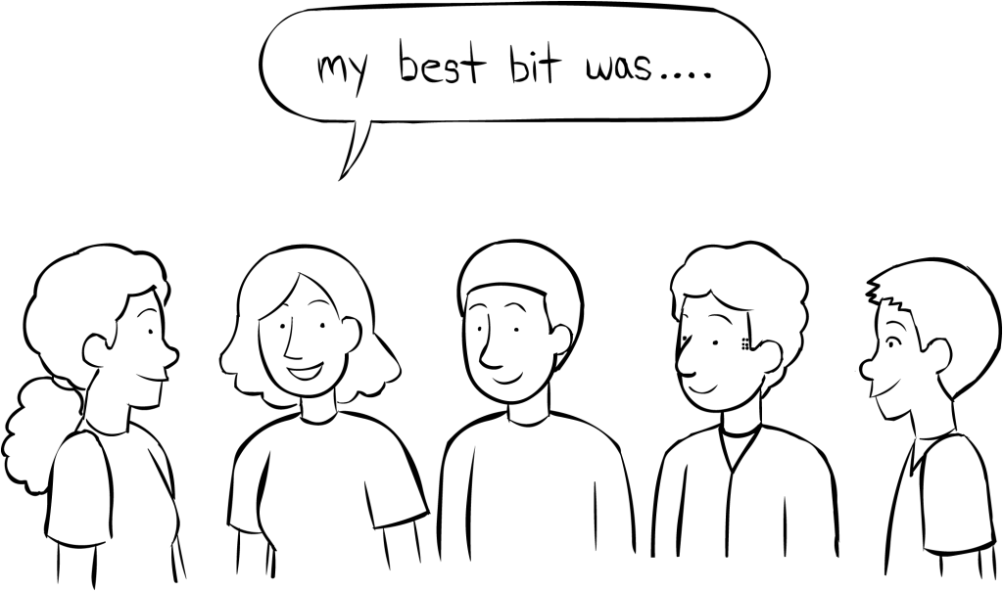
Stand Up
Did you reach your goals today?
If not, what steps do you need to take to ensure you reach today's goals before next class?
Notes:
Teacher Notes:
A Whiparound should happen very quickly, but it is still an important part of class! Determine what order the students go in. Give some think time and have students rapidly fire off their sentences.

